Slide 1
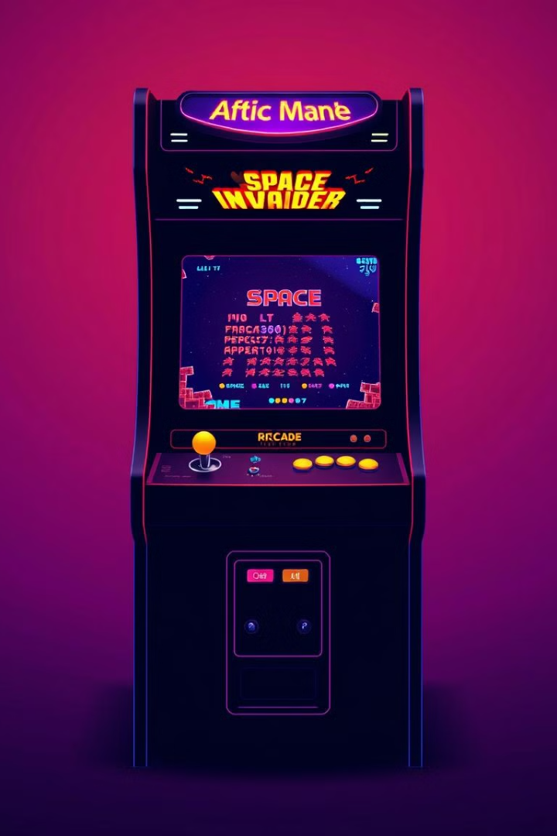
Space Invader Game by Python
This presentation guides you through building a classic Space Invader game using Python. Learn the fundamental concepts of game development, from setting up the environment to implementing key features like player movement, shooting, and collision detection.

Slide 2
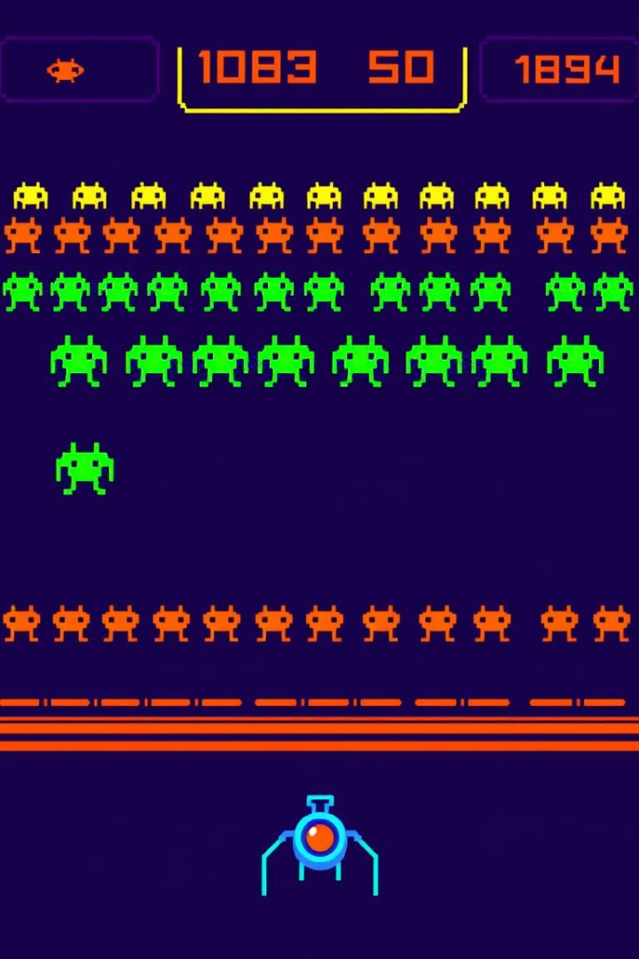
Introduction to Space Invader
1
Classic Arcade Game
2
Objective
The Space Invader game was one of the first arcade games, introduced in the late 1970s.
The objective is to control a spaceship and destroy waves of descending alien invaders.
3
Gameplay
Players shoot lasers at the invaders, earning points for each destroyed invader.

Slide 3
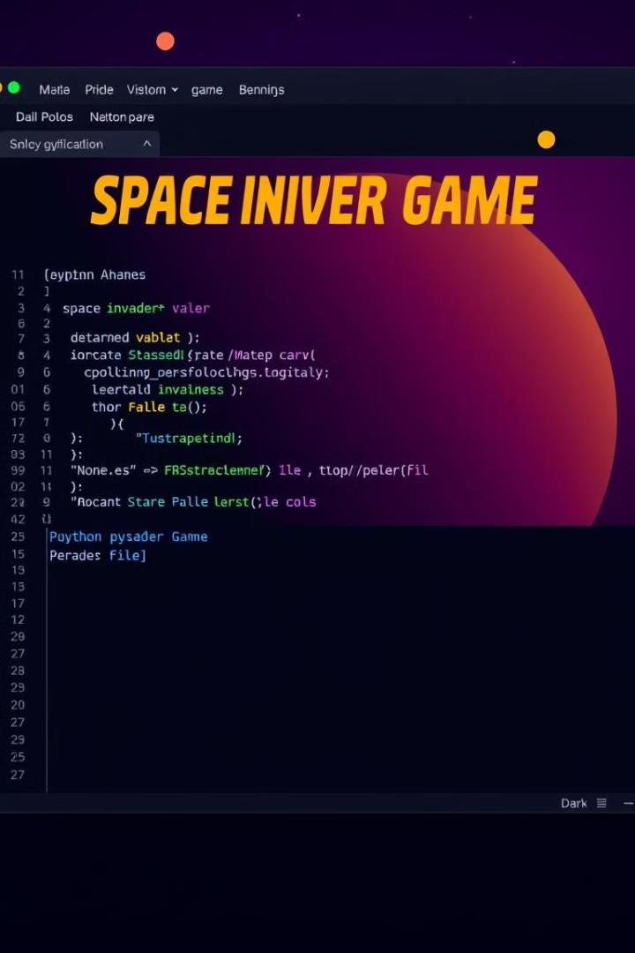
Setting up the Game Environment
1
Install Python
Download and install the latest version of Python from the official website.
2
Choose a Library
Select a suitable game development library like Pygame or Arcade, which provides tools for graphics, sound, and input handling.
3
Create a Project
Set up a new Python project folder and create a main Python file to write your game code.

Slide 4
Creating the Player and Alien Sprites
Player Sprite
Alien Sprite
Sprite Library
Create a simple image or graphic for your player spaceship.
Design a visually distinct image for the alien invaders, considering their appearance and behavior.
Consider using a sprite library or creating your own sprites using image editing software.

Slide 5




Handling Player Input and Movement
Input Detection
Movement Logic
Boundaries
Use the library's input functions to detect key presses or joystick movements.
Update the player's position on the screen based on the detected input.
Implement logic to prevent the player from moving off the screen boundaries.

Slide 6
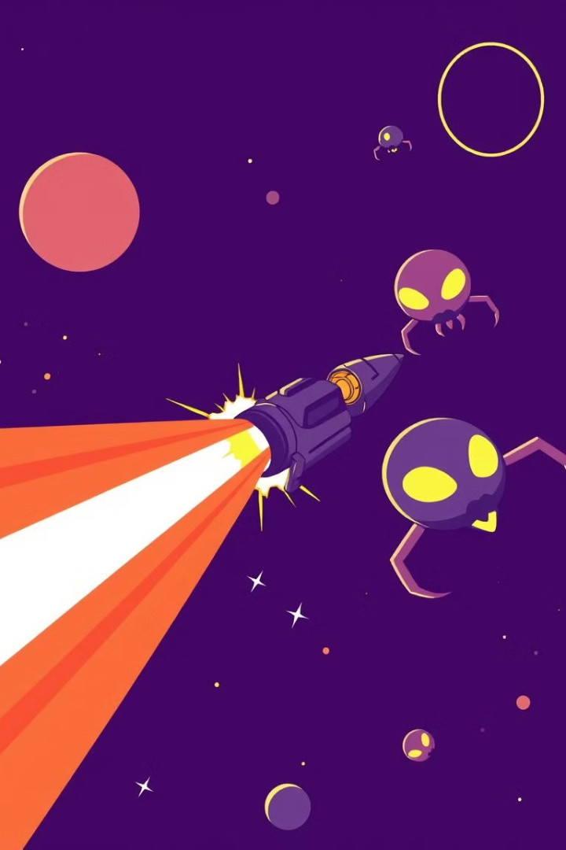
Implementing Shooting and Collision Detection
Shooting Mechanism
Collision Detection
Create a function to fire lasers from the player spaceship at a defined frequency or upon user input.
Implement a function to check if the lasers intersect with any alien invaders.
Destruction
Remove the destroyed invaders and lasers from the game, potentially adding visual effects like explosions.

Slide 7

Scoring and Game Over Mechanics
Score
Increase the score for each destroyed invader.
Lives
Give the player a limited number of lives, deducting one life when the player is hit by an invader.
Game Over
End the game when the player runs out of lives or when all invaders reach the bottom of the screen.

Slide 8
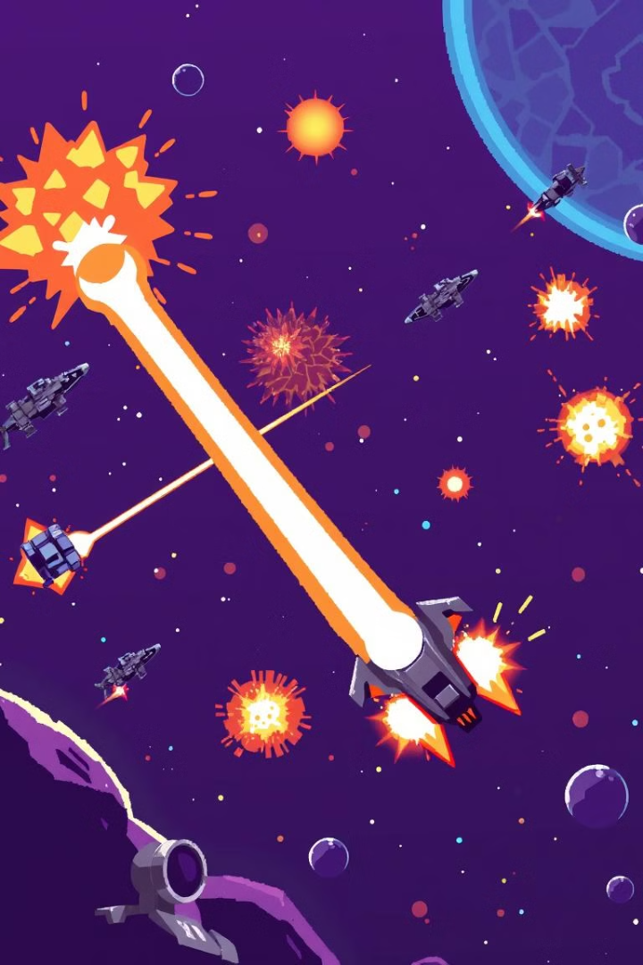



Enhancing the Game with Sound and Visual Effects
Background Music
Add a looping background music track to create an immersive atmosphere.
Sound Effects
Include sound effects for laser fire, alien destruction, and other events to enhance the gameplay experience.
Visual Effects
Add visual effects like explosions, flashing screens, and power-ups to create a more engaging and exciting game.

Slide 9

Conclusion and Next Steps
Congratulations on completing your Space Invader game. You can enhance it further by adding levels, power-ups, boss battles, and multiplayer support. Use your creativity and experiment with different game mechanics to create a unique and exciting experience.

